Slide 1

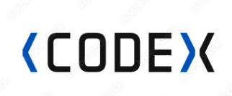

Survey Insights &
Marketing Plan
Presented By :
Vishwajeet Raut

Slide 2
Objective
Company
Context
Problem statement
Code-X is a German beverage company that is aiming to make its mark in the Indian market.
A few months ago, they launched their energy drink in 10 cities in India.Their Marketing team is responsible for increasing brand awareness, market share, and product development.They conducted a survey in those 10 cities and received results from 10k respondents.
convert these survey results to meaningful insights which the team can use to drive actions.

Slide 3
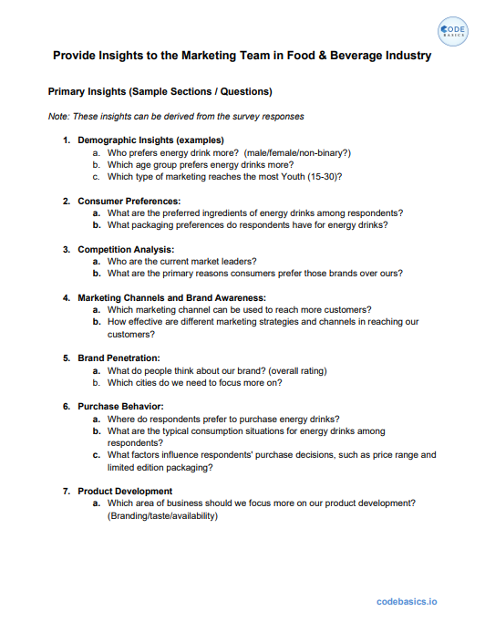
Primary
Insights

Slide 4
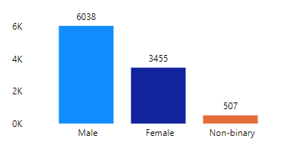
1.Who prefers energy drink more ? (M/F/NB)
The data analysis shows that more males (6038 or 58.4%) prefer energy drinks compared to females (3455 or 33.4%) and non-binary individuals (507 or 4.9%). This means that a larger number of male respondents enjoy energy drinks compared to the other.

Slide 5
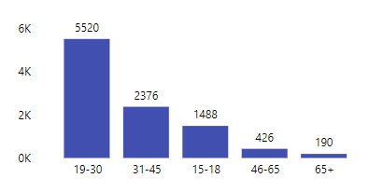
2.Which age group prefers energy drink more ?
From above graph, it is revealed that among the surveyed age groups, the 19-30 age group comprising 5520 respondents exhibits a higher preference for energy drinks. Comparatively, the other age group.
The 46-65 age group with 426 respondents, and the 65+ age group with 190 respondents demonstrate a relatively lower inclination towards consuming energy drinks.
This insight suggests that energy drinks are particularly popular among the younger adult population, specifically those aged 19-30.

Slide 6
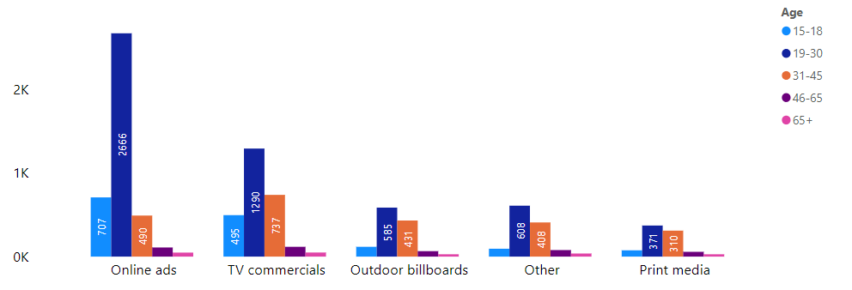
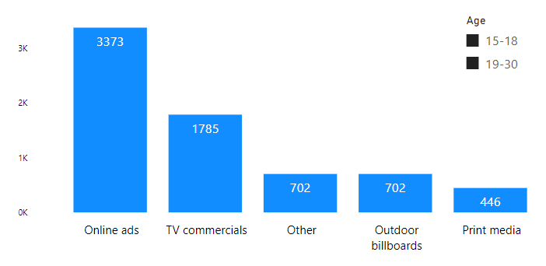
3.Which type of marketing reaches the most youth ? (15-18 & 19-30)
The data analysis reveals that a considerable number of respondents, specifically 3373 individuals, stated that they became aware of energy drinks through online ads.
This insightful information indicates that online ads have been more successful in reaching and informing the younger audience, highlighting their effectiveness in capturing the attention of the youth compared to other marketing channel.

Slide 7
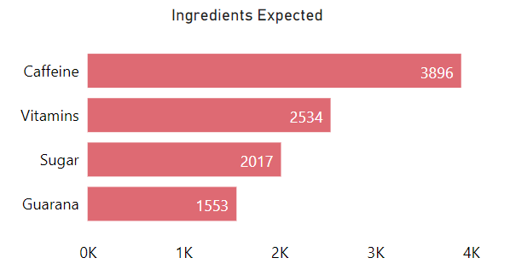
4.What are the prefered ingredients of energy drinks among respondents ?
Caffeine emerges as the most favored ingredient, preferred by 3896 individuals. Vitamins are the next popular choice, with 2534 individuals showing a preference for them. Sugar is favored by 2017 individuals, while guarana is the preferred ingredient for 1553 respondents.
These findings shed light on the most sought-after ingredients in energy drinks, ranking caffeine as the top choice, followed by vitamins, sugar, and guarana.

Slide 8
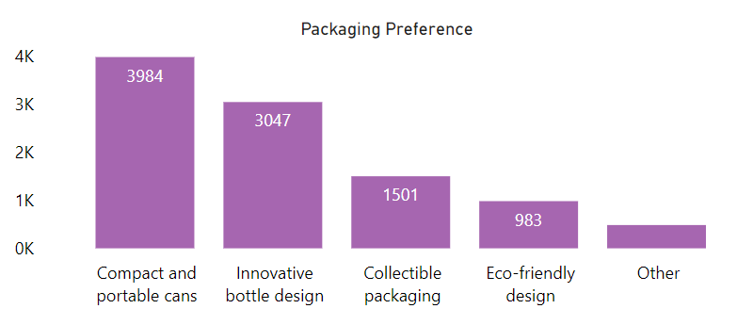
5.What packaging preferences do respondents have for energy drinks ?
Through data analysis, it has been determined that among the respondents, a significant majority of 3984 individuals expressed a preference for compact and portable cans as the preferred packaging for energy drinks. Following closely, 3047 respondents favored innovative bottle designs.
This analytical insight provides valuable information on the packaging preferences among the surveyed population, with compact and portable cans being the most favored option, followed by innovative bottle designs, collectable packaging, and eco-friendly designs.

Slide 9
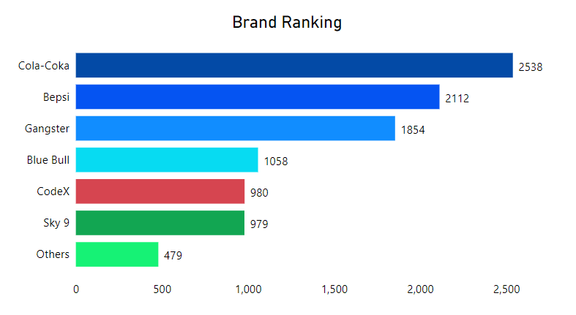
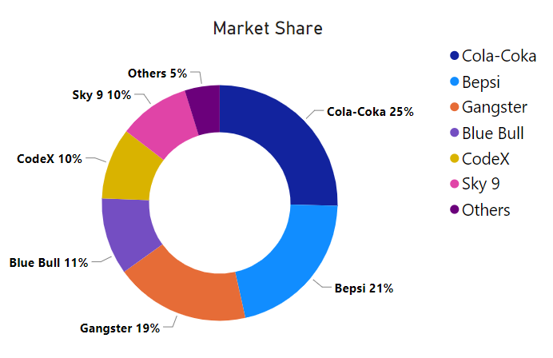
6.Who are the current market leaders ?

Slide 10
The insightful analysis of brand ranking and market share reveals that Cola-Coka secures the first place, being the current market leader, with 2538 respondents expressing a preference for the brand, which corresponds to a market share of 25%.
Bepsi claims the second place with 2112 respondents, accounting for a market share of 21%. Gangster follows closely in the third place with 1854 respondents and a market share of 19%.
Blue Bull ranks fourth with 1058 respondents, representing an 11% market share.
Codex and Sky9 compete for the fifth and sixth places respectively, both with a market share of 10%, as indicated by 980 and 979 respondents respectively.
This information provides valuable insights into both the brand rankings and their corresponding market shares, highlighting the dominant position of Coca-Cola and the distribution of market shares among the surveyed brands.

Slide 11
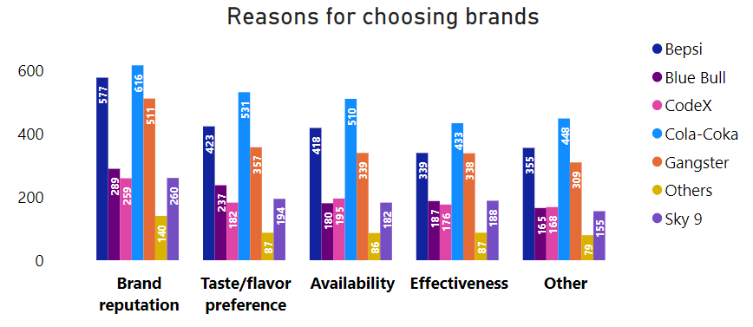
7.What are the primary reasons ,consumers prefer those brands over ours ?

Slide 12
The analysis of key parameters for choosing a brand reveals the following insights:
Brand reputation: Cola-Coka ranks first with 616 respondents, followed by Bepsi with 577 respondents, and Gangster with 511 respondents.
Taste/flavour preference: Cola-Coka remains in the first rank with 531 respondents, followed by Bepsi with 423 respondents, and Gangster with 357 respondents.
Availability: Cola-Coka ranks first with 510 respondents, followed by Bepsi with 418 respondents, and Gangster with 339 respondents.
Brand effectiveness: Cola-Coka secures the first rank with 433 respondents, followed by Bepsi with 339 respondents, and Gangster with 338 respondents.
These insights highlight the significance of brand reputation, taste/flavour preference, availability, and brand effectiveness as key factors influencing consumers' brand choices.

Slide 13
Based on the analysis, consumers prefer brands like Cola-Coka, Bepsi, and Gangster over Codex due to several primary reasons:
1. Brand Reputation: Cola-Coka and Bepsi have higher brand reputations compared to Codex, with a larger number of respondents recognizing their strong brand image. This reputation may instill trust and confidence in consumers, leading them to choose these brands over Codex.
2. Taste/Flavour Preference: Cola-Coka and Bepsi, being the top choices in terms of taste and flavour preference, attract more consumers compared to Codex. The respondents' preference for these brands' taste and flavour profiles plays a crucial role in their brand selection.
3. Availability: Cola-Coka and Bepsi are perceived as more readily available brands compared to Codex. This wider availability makes them more accessible to consumers, increasing their preference for these brands over Codex.
4. Brand Effectiveness: Cola-Coka and Bepsi are perceived as more effective brands, according to the respondents. This effectiveness may include factors such as brand communication, marketing strategies, and overall brand impact, which resonates with consumers and influences their choice in favour of these brands over Codex.
These primary reasons, including brand reputation, taste/flavour preference, availability, and brand effectiveness, contribute to consumers' preference for brands like Cola-Coka and Bepsi, positioning them as more appealing options compared to Codex.

Slide 14
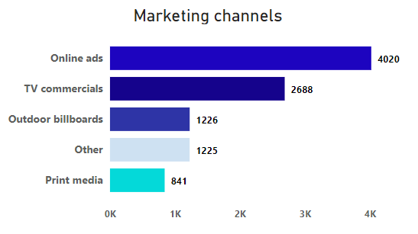
8.Which marketing channel can be used to reach more customers ?
The insightful analysis suggests that online ads are an effective marketing channel for reaching a larger customer base, as indicated by 4020 respondents becoming aware through this medium. TV commercials also play a significant role, with 2688 respondents getting aware through this channel. Outdoor billboards and other channels are also influential, as 1226 and 1225 respondents respectively reported awareness through these mediums. Print media, although still relevant, had a comparatively lower impact, with 841 respondents becoming aware through this channel.
This information highlights the potential of online ads and TV commercials as key marketing channels for reaching a broader customer audience.

Slide 15
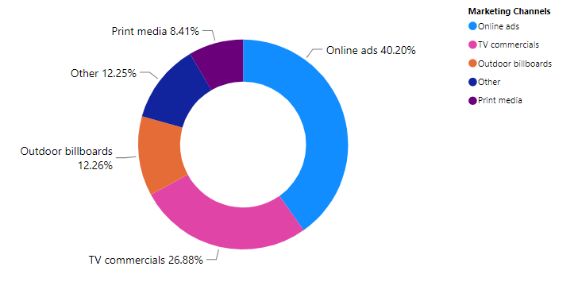
9.How effective are different marketing strategies and channels in reaching our customers ?
The analysis reveals the effectiveness of different marketing strategies and channels in reaching customers. Online ads prove to be highly effective, reaching 40.20% of customers. TV commercials are also impactful, reaching 26.88% of customers. Outdoor billboards and other channels demonstrate moderate effectiveness, reaching 12.26% and 12.25% of customers respectively. Print media shows a relatively lower effectiveness, reaching 8.41% of customers.
These insights indicate that online ads and TV commercials are the most effective marketing strategies for reaching a larger customer base, while other channels have varying degrees of effectiveness.

Slide 16
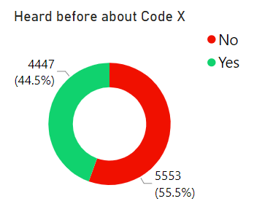
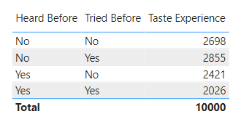
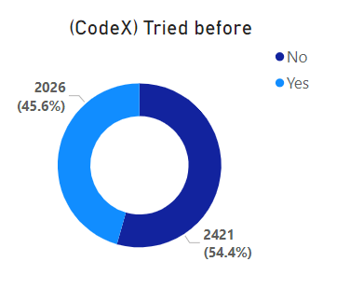
10.What do people think about our brand ? (Overall Rating)
The data analysis reveals that among the respondents, a total of 4447 individuals, accounting for 44.5%, have heard about our brand Codex.
It is important to note that not all respondents may have answered the questions sincerely, hence taking into consideration only those who have heard about Codex, the respondents were classified into two categories: "tried before" and "not tried before."
Among the 4447 respondents who have heard about Codex, 2026 individuals, representing 45.6%, have tried the product before, while 2421 individuals, accounting for 54.4%, have not tried it. This data insight suggests that further analysis and consideration of respondent sincerity are necessary to ensure accurate and meaningful conclusions from the data.

Slide 17
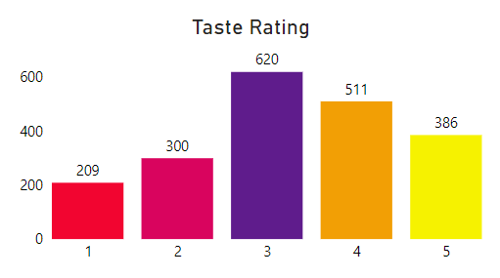
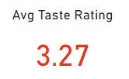
The insightful analysis of the data highlights that out of the 2026 individuals who have tried the product, a significant proportion rated it highly. Specifically, 386 individuals (45.6%) awarded it 5 stars, 511 individuals (25.2%) gave it 4 stars, and 620 individuals (30.7%) rated it with 3 stars.
The average rating of 3.27 indicates a moderately positive overall sentiment towards the product. These findings suggest that the majority of individuals who have tried the product have expressed favourable opinions, contributing to a generally positive perception.

Slide 18
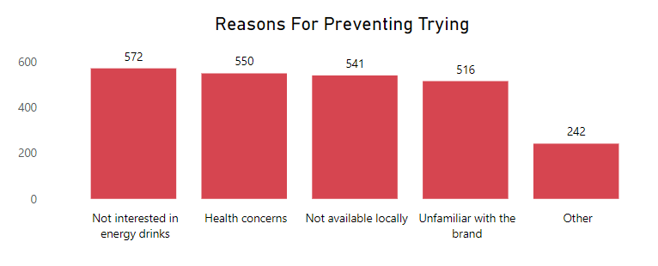
Among the 2421 individuals who have not tried the product, diverse reasons contribute to their decision. The most prevalent factors include lack of interest in energy drinks, cited by 572 individuals (23.6%); concerns about health effects, expressed by 550 individuals (22.7%); unavailability of the product locally, mentioned by 541 individuals (22.3%); and unfamiliarity with the brand, reported by 516 individuals (21.4%).
This insightful information highlights the various barriers preventing these individuals from trying the product, providing valuable insights for potential improvements and targeted marketing strategies.
These insights provide valuable information about the product's perceived quality based on ratings from those who have tried it. Furthermore, understanding the reasons for not trying the product helps identify potential barriers and areas for improvement in order to attract a larger customer base.

Slide 19
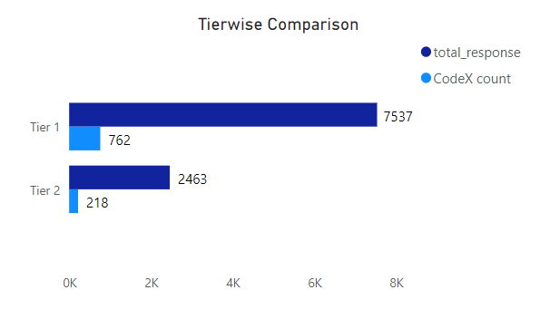
11.Which cities do we need to focus more on ?
To maximize marketing efforts, it is advisable to focus more on tier 1 cities due to their higher demand for energy drinks. Specifically, allocate resources to strengthen the presence of the codex brand in tier 1 cities, where it already enjoys a strong response of 762 out of 7537.
While tier 2 cities have a lower overall response, still consider targeted strategies to increase brand penetration, leveraging the existing response of 218 out of 2463 to the codex brand.

Slide 20
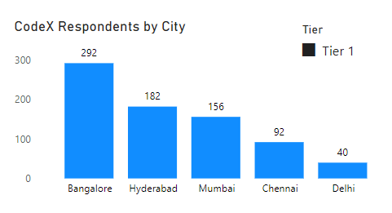
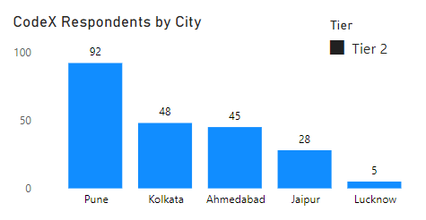
In tier 1 cities, Bangalore has the highest engagement with 292 respondents, followed by Hyderabad (182), Mumbai (156), Chennai (92), and Delhi (40).Therefore, the primary focus should be on Bangalore and Hyderabad in tier 1 cities due to their higher response rates.
Among tier 2 cities, Pune has the highest response with 92 respondents, followed by Kolkata (48), Ahmedabad (45), Jaipur (28), and Lucknow (5).Thus, the main focus for tier 2 cities should be on Pune and Kolkata, which exhibit greater engagement levels.
Marketing Strategies: For tier 1 cities, tailored marketing approaches should be employed to further penetrate the markets in Mumbai, Chennai, and Delhi.
Additionally, targeted efforts should be made to increase brand awareness and penetration in Ahmedabad and Jaipur. In tier 2 cities, strategies should be intensified in Pune and Kolkata to capitalize on their higher engagement levels. Meanwhile, exploring growth opportunities in Ahmedabad, Jaipur, and Lucknow should be approached with measured strategies to maximize market potential.

Slide 21
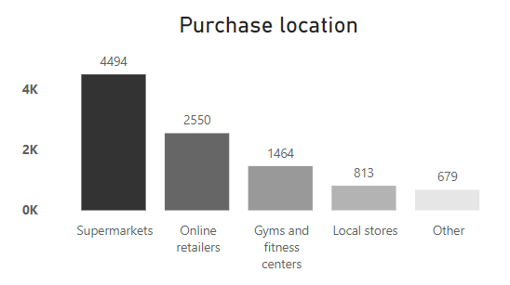
12.Where do respondents prefer to purchase energy drinks ?
The data indicates that supermarkets and online retailers are the primary channels of choice for a significant number of respondents, with 4494 and 2550 respondents respectively. Therefore, a key focus should be on establishing strong partnerships with supermarkets and optimizing online retail platforms to make the energy drinks easily accessible to consumers.
In addition, the data shows that a considerable number of respondents, 1464, prefer purchasing energy drinks from gyms and fitness centers. This presents an opportunity to strategically collaborate with fitness establishments to offer energy drinks as part of their fitness and performance-oriented offerings.

Slide 22
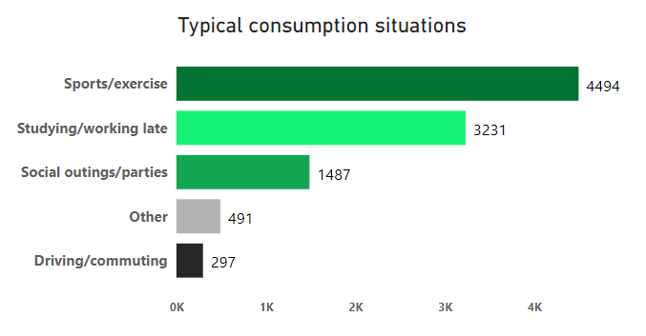
13.What are the typical consumption situations for energy drinks among respondents ?
Insightful data reveals the typical consumption situations for energy drinks among respondents. The majority, 4494 respondents, consume energy drinks for sports/exercise, indicating their association with physical activity.
Additionally, 3231 respondents consume energy drinks for studying/working late, highlighting their role in enhancing focus and alertness.
Social outings/parties serve as a consumption situation for 1487 respondents, showcasing the social aspect of energy drink consumption.
Furthermore, 491 respondents consume energy drinks for other unspecified reasons, reflecting diverse individual preferences.
Notably, 297 respondents specifically consume energy drinks for driving/commuting, suggesting their perceived role in providing alertness during these activities.

Slide 23
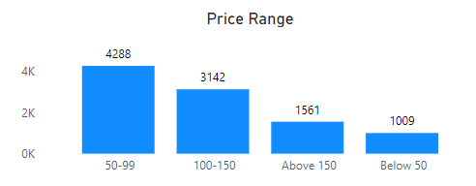
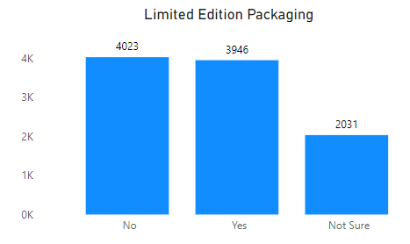
14.What factors influence respondents purchase decisions such as price range and limited edition packaging?
Price range and limited edition packaging are influential factors in respondents' purchase decisions for energy drinks. With 4288 respondents preferring a price range of 50-99 and 3142 respondents opting for 100-150, competitive pricing within these ranges can be a key marketing strategy.
Additionally, while 3946 respondents desire limited edition packaging, it is important to note that 4023 respondents do not consider it a significant factor.
This insight highlights the importance of offering competitive pricing within preferred ranges and selectively incorporating limited edition packaging to cater to the target audience's preferences.

Slide 24
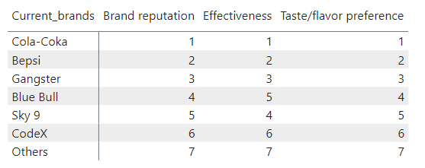
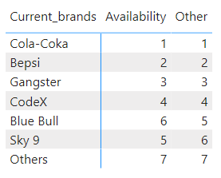
15.Which area of business should we focus more on our product development ? (Branding/Taste/Availability)
Based on the analysis of key parameters for choosing a brand, the insights suggest that there is a need to focus more on product development in the areas of branding and taste/flavour.
The analysis reveals that brands like Cola-Coka and Bepsi have higher rankings and preferences in terms of brand reputation, taste/flavour preference, availability, and brand effectiveness compared to Codex. This indicates that consumers are more inclined towards these brands due to their stronger brand image, taste appeal, wider availability, and perceived effectiveness.
Therefore, to enhance product development, efforts should be directed towards strengthening the brand reputation and improving the taste/flavour profile of the product. Building a strong brand image, ensuring consistent quality, and offering a desirable taste experience can help attract and retain more consumers.

Slide 25
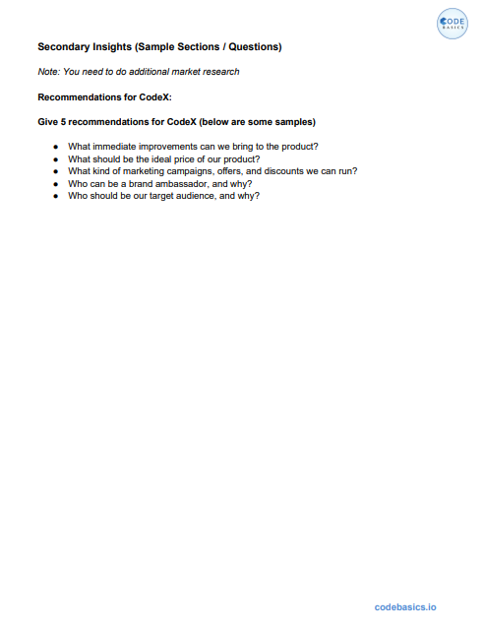
Secondary
Insights

Slide 26
1.What immediate improvements can we bring to the product ?
Based on the primary insights from the data, here are some immediate improvements we can consider for our energy drink product:
1. Enhance flavor profiles based on consumer feedback to ensure a more appealing taste experience.
2. Invest in brand reputation building activities to establish a strong and trustworthy image in the market.
3. Innovate packaging designs to create visual appeal and attract consumer attention.
4. Optimize ingredients to align with consumer preferences, such as reducing sugar content or introducing
natural alternatives.
5. Develop health-conscious options that cater to the growing demand for healthier energy drink choices.
6. Expand availability by establishing strong partnerships with supermarkets and optimizing online retail
platforms to make the energy drinks easily accessible to consumers.
7. Focus on product differentiation by identifying unique features or benefits that set our energy drinks apart
from competitors.
By implementing these improvements, we can enhance consumer satisfaction, attract a wider customer base, and strengthen our position in the energy drink market.

Slide 27
2.What should be the ideal price of our product ?
Based on the insights, the ideal price range for our energy drink product, Codex, should be set between Rs 50 and Rs 150. This range aligns with the preferred price ranges indicated by the respondents, with 4288 individuals preferring prices in the Rs 50-99 range and 3142 individuals opting for prices in the Rs 100-150 range.
Setting the price within this range ensures that our product remains competitive in the market while also meeting customer expectations. It is important to conduct a thorough analysis of our production costs, including ingredients, manufacturing, packaging, and distribution expenses, to determine the specific price point within the recommended range that will allow for profitability.
Consider conducting market research and competitive analysis to evaluate the pricing strategies of our competitors. Assess the perceived value of Codex compared to other energy drink brands in the market and position it accordingly. Emphasize the unique qualities and benefits of our product to justify its price and differentiate it from competitors.
Incorporate our pricing strategy into our overall marketing plan. Communicate the value proposition of Codex through targeted marketing campaigns, highlighting the quality, taste, performance-enhancing benefits, and unique features of our energy drink to justify the chosen price point.
Ultimately, the ideal price of Codex should strike a balance between customer affordability, perceived value, and profitability for our business.

Slide 28
3.Who should be our target audience & why ?
Our target audience for Codex should primarily consist of individuals aged 19-30 who are active, health-conscious, and value the benefits of energy drinks. This age group has shown a higher preference for energy drinks and represents a significant market segment.
Reasons for targeting this audience include:
1. High Energy Demands: Individuals in the 19-30 age range often lead busy lifestyles that involve studying, working, and engaging in
physical activities. They require sustained energy levels and mental focus, making them more likely to seek out energy drinks as a
solution.
2. Active and Fitness-Oriented: This age group is often involved in sports, exercise, and fitness activities. Positioning Codex as a drink
that enhances performance and aids in recovery can resonate with their active lifestyle and fitness goals.
3. Trend and Lifestyle Conscious: The 19-30 age group is highly influenced by trends and seeks products that align with their lifestyle
choices. By emphasizing Codex's unique features, taste, and packaging, we can capture their attention and appeal to their desire for
innovative and stylish products.
4. Health-Conscious: Young adults prioritize health and wellness. By emphasizing the use of natural ingredients, lower
sugar content, and functional benefits in Codex, we can cater to their health-conscious preferences and differentiate our product from
competitors.
5. Tech-Savvy and Social Media Users: This age group is highly connected through social media platforms and online channels.
Utilizing targeted digital marketing campaigns, influencer collaborations, and engaging social media content can effectively reach
and engage with our target audience.
By focusing on this target audience, we can tailor our marketing messages, product features, and distribution channels to meet their specific needs and preferences. This targeted approach will increase the chances of capturing their attention, generating brand loyalty, and driving sales for Codex.

Slide 29
4.What kind of marketing campaigns,offers & discounts ,we can run ?
Fitness and Sports Campaigns: Collaborate with fitness influencers and sports clubs to promote the energy drinks as a
performance enhancer.
Gamers and E-Sports Promotions: Collaborate with gaming influencers and e-sports organizations to promote energy drinks as the ideal companion for gaming sessions.
Loyalty Programs: Implement a loyalty program that rewards customers for repeat purchases or referrals.
Limited-Time Offers and Bundles: Create special promotions like buy-one-get-one-free or discounts on multiple purchases.
Seasonal and Festive Campaigns: Align marketing campaigns with seasonal events, holidays, or festivals.
Discount on Sports Accessories: Collaborate with sports equipment retailers to offer exclusive discounts for energy drink consumers.
Partnership with Music Apps: Form partnerships with music streaming platforms to provide perks like free premium subscriptions or curated workout playlists.
By implementing these marketing strategies, offering discounts, and running targeted campaigns, the brand can effectively engage with energy drink consumers, build brand loyalty, and attract new customers.

Slide 30
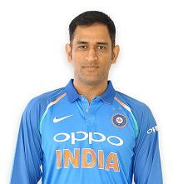
5.Who can be a brand ambassador & why ?
India is a diverse country where connecting all Indians is nearly impossible due to cultural, regional, and lifestyle variations. However, cricket stands out as the one thing that unites every Indian, transcending differences in region, lifestyle, food, religion, and festivals. Metaphorically, the Indian Premier League (IPL) can be considered India's grandest festival. Therefore, Codex should choose Indian cricket celebrity Mahendra Singh Dhoni as their brand ambassador. Dhoni's immense popularity, legendary status, and ability to connect with fans make him an ideal choice to represent the brand and establish a strong connection with the target audience.

Slide 31
Mahendra Singh Dhoni, popularly known as MS Dhoni, could be an excellent choice as a brand ambassador for Codex Company. Here's why:
1. Strong Leadership: Dhoni is known for his exceptional leadership skills and calm demeanor, making him a perfect fit for representing Codex as a brand that exudes confidence and reliability.
2. Sports Icon: As one of India's most successful cricketers and former captain of the Indian cricket team, Dhoni has a massive fan following and is highly respected in the sports community. His association with Codex can attract sports enthusiasts and create a positive brand image.
3. Fitness Enthusiast: Dhoni has maintained his fitness throughout his career, which aligns well with Codex's emphasis on a healthy and active lifestyle. His endorsement can reinforce the energy drink's benefits for sports and fitness enthusiasts.
4. Trustworthy Image: Dhoni is known for his honesty, integrity, and strong work ethic. His trustworthiness can enhance Codex's brand reputation and establish a sense of reliability among consumers.
5. Pan-India Appeal: Dhoni enjoys immense popularity across different regions of India, making him an influential figure to reach a wide audience. His involvement can help expand Codex's reach and connect with consumers from various demographics.
Considering Dhoni's leadership qualities, sports icon status, fitness focus, trustworthiness, and pan-India appeal, he could be an impactful brand ambassador for Codex Company.

Slide 32
Thank You

